Slide 1




The Architecture of a Mutual Fund
NISM Series V-A | Module 2 — Understanding the legal structure, key entities, and regulatory framework that govern mutual funds in India.
MODULE 2
NISM SERIES V-A
Notes:
1

Slide 2


Legal Structure: A Trust at Its Core
In India, a Mutual Fund is constituted as a Trust under the Indian Trusts Act, 1882. This structure is deliberate — it ensures investor funds are legally protected and cannot be misused by any single party.
The trust structure creates a clear separation between those who manage money and those who own it — a foundational safeguard for unitholders.
The architecture is divided across five independent entities, each with a distinct and non-overlapping role.
Notes:
2

Slide 3
The Five Key Entities
Sponsor
Trustees
AMC
The founder. Establishes the trust, brings initial capital, and registers the fund with SEBI.
Protect investor interests. Hold fund property in trust and ensure AMC compliance with SEBI.
The operational brain. Employs fund managers who make day-to-day investment decisions.
Custodian
RTA
Independently safekeeps all securities. The AMC never holds assets directly.
Back-office administrator. Handles investor records, KYC, statements, and dividends.
Notes:
3

Slide 4
Entity Deep Dive: Roles & Responsibilities
Sponsor
Trustees
The promoter — think HDFC Bank or SBI. They apply to SEBI, establish the trust deed, and appoint the initial Trustees. They bear ultimate accountability for the AMC's conduct.
Appointed by the Sponsor, Trustees are the guardians of unitholders. They hold fund assets in trust, supervise the AMC, and can terminate the AMC's appointment if needed.
AMC (Asset Management Company)
Custodian & RTA
Appointed by Trustees to run daily operations. Fund managers and analysts here decide which securities to buy or sell across all schemes offered by the fund.
Custodian: Safekeeps physical and electronic securities — completely independent of the AMC. RTA (e.g., CAMS, KFintech): Processes investor applications, maintains folios, dispatches account statements, and manages payouts.
Notes:
4

Slide 5
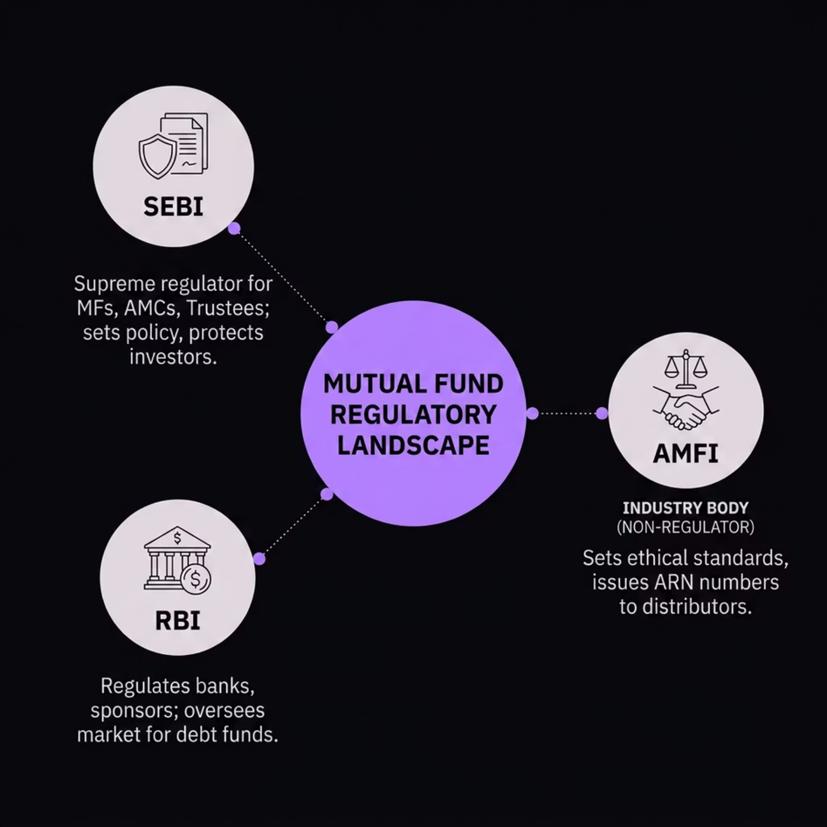

The Regulatory Landscape
Three Bodies, Distinct Roles
SEBI is the supreme authority. Every mutual fund, AMC, and Trustee must be registered with SEBI.
RBI indirectly intersects — it regulates banks (potential sponsors) and the money market where debt funds operate.
Exam Trick: AMFI is NOT a regulator. It is an industry association/trade body formed by AMCs. Never confuse it with SEBI.
Notes:
5

Slide 6
What Is AMFI?
Association of Mutual Funds in India
Quick Recall
AMFI was established by all AMCs collectively to serve as the industry's self-regulatory association. It is not a statutory regulator — it does not have the power to frame law.
SEBI = Regulator (Statutory)
RBI = Indirect Regulator (Money Market & Banks)
  Sets ethical standards and a code of conduct for the industry
  Issues the ARN (AMFI Registration Number) to mutual fund distributors
  A distributor cannot legally sell mutual funds without a valid ARN
AMFI = Industry Body (Non-Statutory)
ARN = Issued by AMFI to distributors
Notes:
6

Slide 7

AMFI Code of Conduct for Distributors
To protect investors and maintain market integrity, distributors must strictly follow AMFI's Code of Conduct. Violations can result in cancellation of the ARN.
Notes:
7

Slide 8









Four Pillars of Distributor Ethics
No Rebating
Full Disclosure
Sharing or returning any portion of commission with the investor to induce investment is strictly illegal.
All trail commissions received from the AMC must be disclosed clearly and honestly to the client.
Suitability & Risk Profiling
No Misrepresentation
Assess financial situation, experience, and risk tolerance before recommending any scheme.
Returns cannot be guaranteed. Must clearly state: "Mutual fund investments are subject to market risks."
Selling high-risk equity funds to a conservative senior citizen is a direct violation of the suitability requirement — a classic exam scenario.
Notes:
8

Slide 9





Module 2: At a Glance
Legal Structure
Trust Structure — Trust under Indian Trusts Act, five entities
Key Entities — Sponsor → Trustees → AMC → Custodian → RTA
Distributor Ethics
Entity Roles
Regulators — SEBI (primary), RBI (indirect), AMFI (industry body)
Distributor Ethics — No rebating, full disclosure, suitability
Regulatory Framework
These four pillars — legal structure, entity roles, regulatory framework, and distributor ethics — form the complete architecture of a mutual fund in India.
Notes:
9

Slide 10


Exam-Ready Key Takeaways
Mutual Fund = Trust
Governed by the Indian Trusts Act, 1882 — not a company or partnership.
Five Entities, Five Roles
Sponsor → Trustee → AMC → Custodian → RTA. Each is independent and non-overlapping.
AMFI ≠ Regulator
AMFI is a trade body. SEBI is the supreme regulator. RBI oversees money markets and bank-sponsors.
ARN is Mandatory
No distributor can operate without a valid AMFI Registration Number.
Notes:
10

